Slide 1
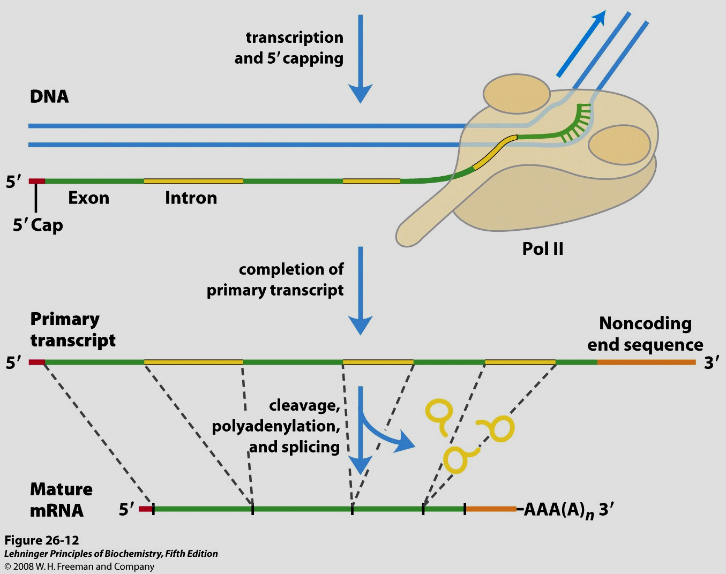
RNA processing
Lecture - 16

Slide 2
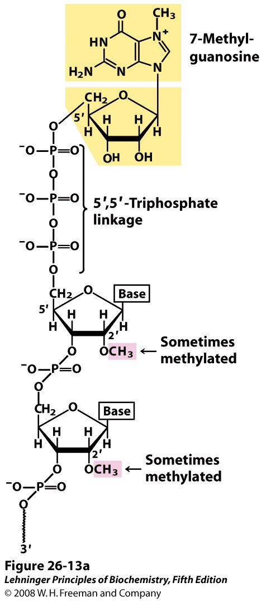
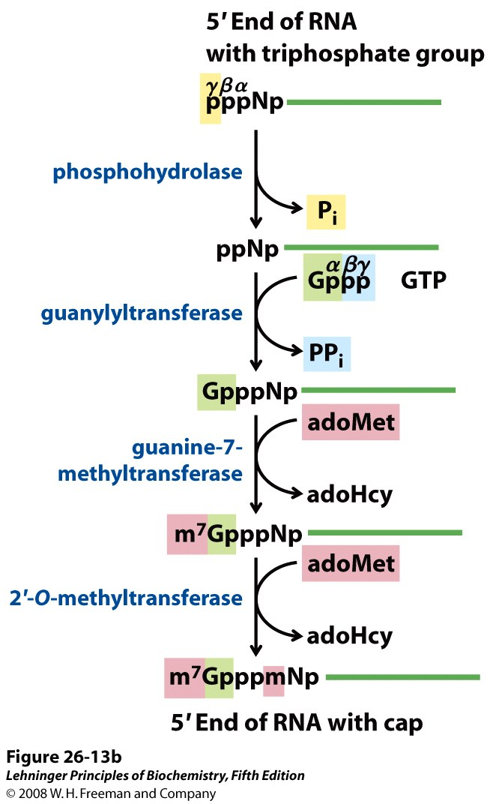
Synthesis of 5’ cap of mRNA
Notes:
S-adenosyl-L-methionine (AdoMet), S-adenosyl-L-homocysteine (AdoHcy)

Slide 3
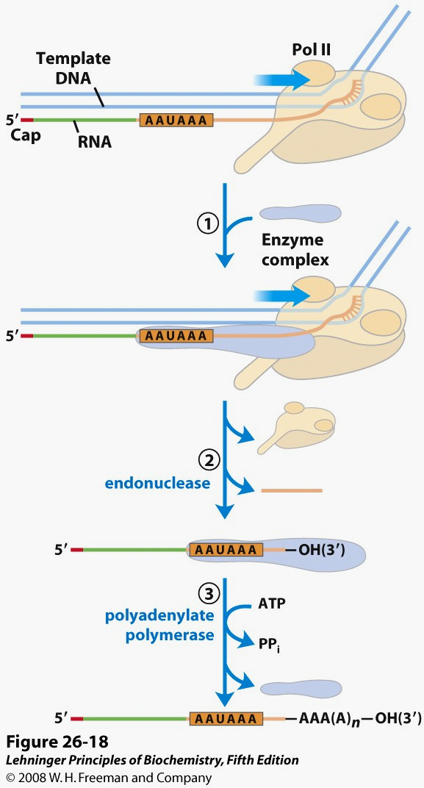
Addition of poly (A) tail

Slide 4
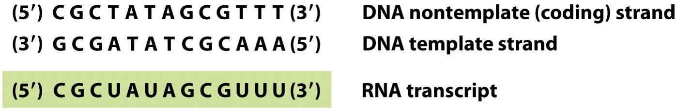
Splicing

Slide 5
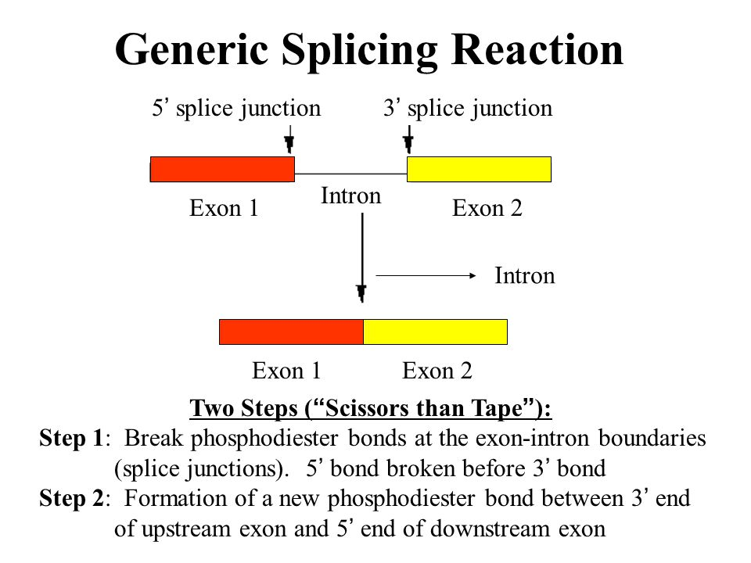

Slide 6
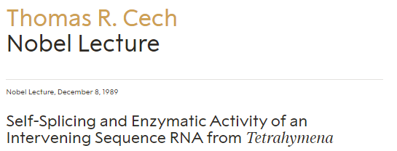
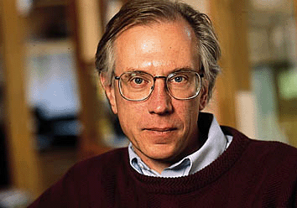

Slide 7
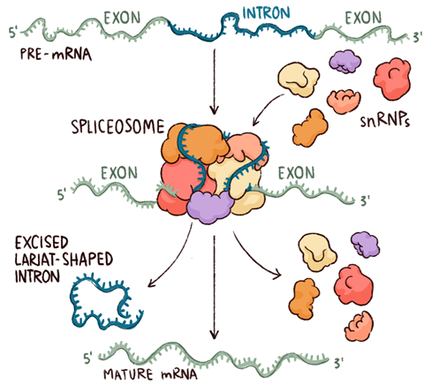
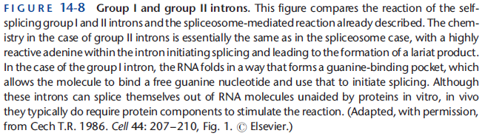
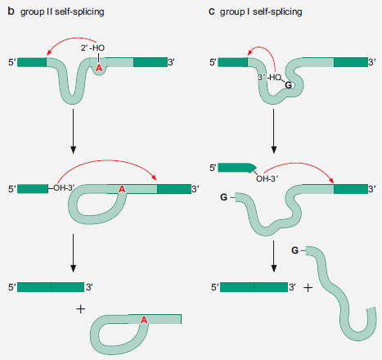
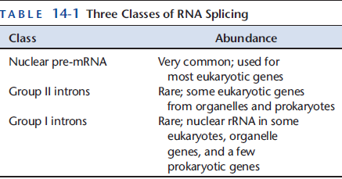
Self-splicing introns

Slide 8
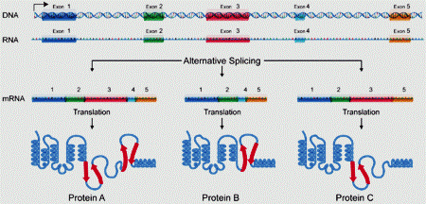
Alternative splicing

Slide 9
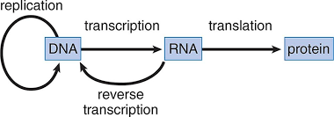
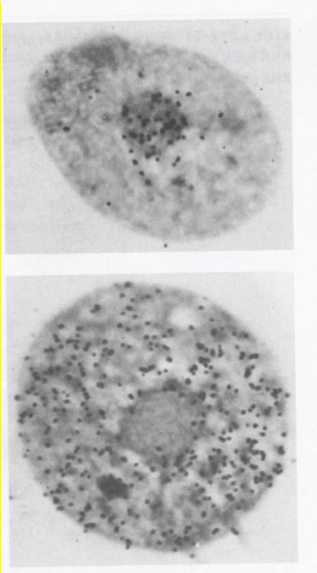
From RNA to Protein
Cells pulse-labelled with ³H coupled cytidine
T = 15 minutes
T = ~90 minutes
Prescott DM, 1964

Slide 10
Transport of mRNAs

Slide 11
Proteins are important
~44% of the dry wt. of the human body.
~5% of human caloric intake goes for protein synthesis.
catalyze most of the reactions in living organisms.
serve many roles (enzymatic, structural, transport, regulation, ...)
…in sickness and in health
protein synthesis is tightly regulated by environmental stimuli
as well as intrinsic processes (e.g., hormonal, developmental).
dysregulation can cause disease.
many antibiotics act at the level of protein synthesis.

Slide 12
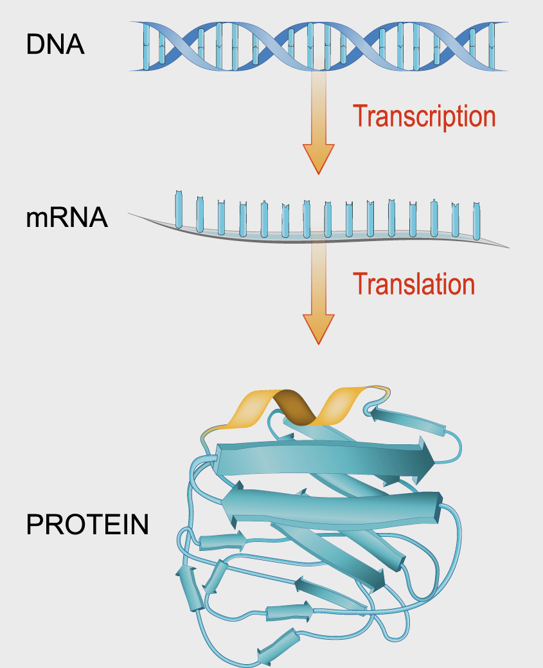
The challenge

Slide 13
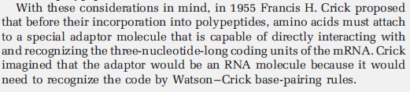
Crick’s Adaptor Hypothesis

Slide 14
Cell free system of protein synthesis in a test tube using radioactive amino acids

Slide 15
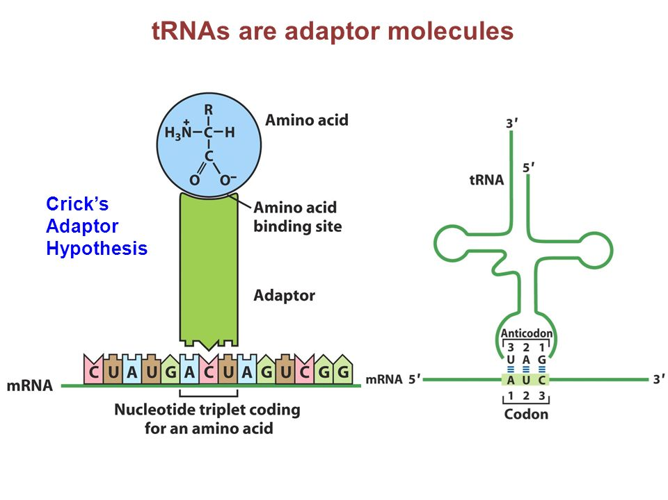

Slide 17
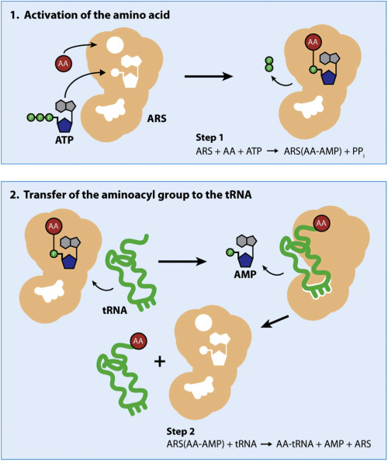
An aminoacyl-tRNA synthetase (aaRS or ARS), also called tRNA-ligase, is an enzyme that attaches the appropriate amino acid onto its corresponding tRNA.

Slide 18
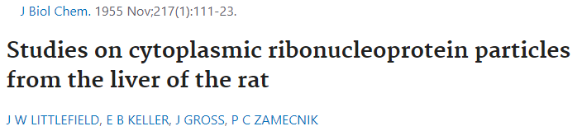

Slide 19
The Secretory Pathway

